Slide 1
Transactions and concurrency
INF08104: Database Systems
Brian Davison, 2014/15

Slide 2
Agenda
Transactions
Transaction control
The transaction log
Concurrency
Locking
Deadlocks
Explicit locking

Slide 3
Transactions
Logical unit of work
May consist of several database operations
All operations must either succeed or fail

Slide 4
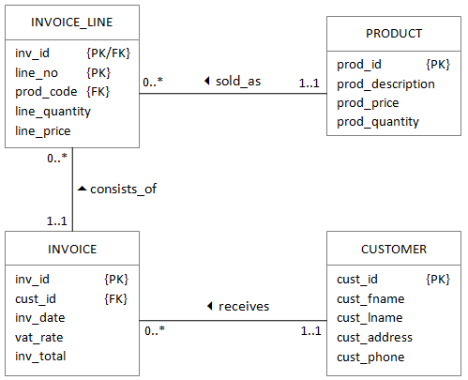
E-commerce transaction example
Insert INVOICE record
Insert LINE for each different PRODUCT
Update each PRODUCT to reduce the prod_quantity
After LINES are inserted, update INVOICE to include tax

Slide 5
Transaction control
INSERT / UPDATE / DELETE …
COMMIT

Slide 6
ROLLBACK
INSERT / UPDATE / DELETE …
ROLLBACK

Slide 7
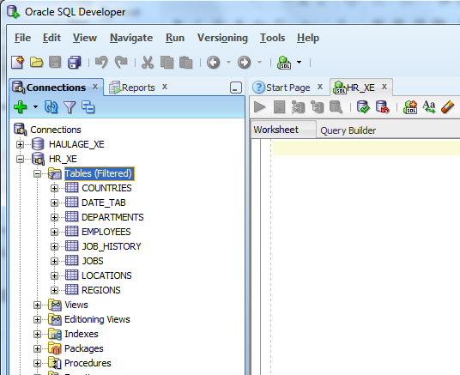
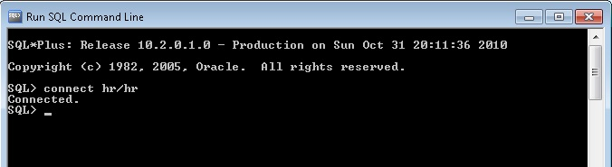
Transaction isolation
HR

Slide 8
ACID
Transactions are:
Atomic They cannot be broken into smaller pieces
Consistent The database always presents a consistent state
Isolated Other users are protected from changes until commit
Durable Changes are permanent

Slide 9
Transaction log
INSERT / UPDATE / DELETE …
COMMIT / ROLLBACK
Transaction log

Slide 10
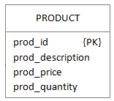
Concurrency
Many simultaneous users
Problems
Inconsistent retrieval
Lost updates
Uncommitted data
To update stock value:
Read current product quantity
Calculate new product quantity
Store new value

Slide 11
Lost updates
Customer1 orders 10 units of a product
Customer2 orders 50 units
Currently, 100 units available
40 remaining
Step 5 is lost ➔
Step | Transaction | Operation | Stored
1 | 1 | Read quantity | 100
2 | 2 | Read quantity | 100
3 | 1 | Calculate: new value = 100 - 10 | 100
4 | 2 | Calculate: new value = 100 - 50 | 100
5 | 1 | Store new value | 90
6 | 2 | Store new value | 50

Slide 12
Uncommitted data
Customer1 orders 10 units but is rolled back
Customer2 orders 50 units
Currently, 100 units available
50 remaining
Uncommitted data ➔
Step | Transaction | Operation | Stored
1 | 1 | Read quantity | 100
2 | 1 | Calculate: new value = 100 - 10 | 100
3 | 1 | Store new value | 90
4 | 2 | Read quantity | 90
5 | 2 | Calculate: new value = 90 - 50 | 90
6 | 1 | ROLLBACK | 100
7 | 2 | Store new value | 40

Slide 13
Locking (lost updates)
Step | Transaction | Operation | Stored
1 | 1 | Obtain locks | 100
2 | 1 | Read quantity | 100
3 | 2 | Wait | 100
4 | 1 | Calculate: new value = 100 - 10 | 100
5 | 2 | Wait | 100
6 | 1 | Store new value | 90
7 | 1 | COMMIT (release locks) | 90
8 | 2 | Obtain locks
9 | 2 | Read quantity | 90
10 | 2 | Calculate: new value = 90 - 50 | 90
11 | 2 | Store new value | 40
12 | 2 | COMMIT (release locks) | 40

Slide 14
Locking (uncommitted data)
Step | Transaction | Operation | Stored
1 | 1 | Obtain locks | 100
2 | 1 | Read quantity | 100
3 | 1 | Calculate: new value = 100 - 10 | 100
4 | 1 | Store new value | 90
5 | 2 | Wait | 90
6 | 1 | ROLLBACK (release locks) | 100
7 | 2 | Obtain locks | 100
8 | 2 | Read quantity | 100
9 | 2 | Calculate: new value = 100 - 50 | 100
10 | 2 | Store new value | 50
11 | 2 | COMMIT (release locks) | 50

Slide 15
Deadlocks
Step | Transaction | Operation | DBMS reply | Table A | Table B
1 | - | - |  | Unlocked | Unlocked
2 | T1 | Lock A | OK | Locked T1 | Unlocked
3 | T2 | Lock B | OK | Locked T1 | Locked T2
4 | T1 | Lock B | Wait | Locked T1 | Locked T2
5 | T2 | Lock A | Wait | Locked T1 | Locked T2
6 | T1 | Lock B | Wait | Locked T1 | Locked T2
7 | T2 | Lock A | Wait | Locked T1 | Locked T2
 |  |  | …

Slide 16
Explicit locks
SELECT * FROM countries WHERE country_id = 'ES' FOR UPDATE;
LOCK TABLE COUNTRIES;
SELECT…
INSERT…
UPDATE…
COMMIT;
Locks query results
Locks released by COMMIT or ROLLBACK

Slide 17
Transaction control
LOCK TABLE invoice;
LOCK TABLE product;
INSERT INTO invoice …
INSERT INTO invoice_line …
UPDATE product SET prod_quantity = …
INSERT INTO invoice_line …
UPDATE product SET prod_quantity = …
UPDATE invoice SET inv_total = …
COMMIT;

